Slide 1

DAMG 6210 - Hospital Database Management System
Group 10
Team Members: Avinash Raikesh - 001090182 Animesh Shukla - 002109910
Shruti Manohar - 001598116
Vandit Kothari - 001046482

Slide 2
Project Overview
A hospital database management system contains information about administration, doctors, patients, diagnoses, and billing.
Billing statements, room assignments based on availability, confirmations, changes, and deletions of patient/staff information will be accessible by the administration.
Diagnoses can be made by a doctor based on symptoms.
HIPAA law makes medical information confidential, so access to this information will not be equal for all users.

Slide 3
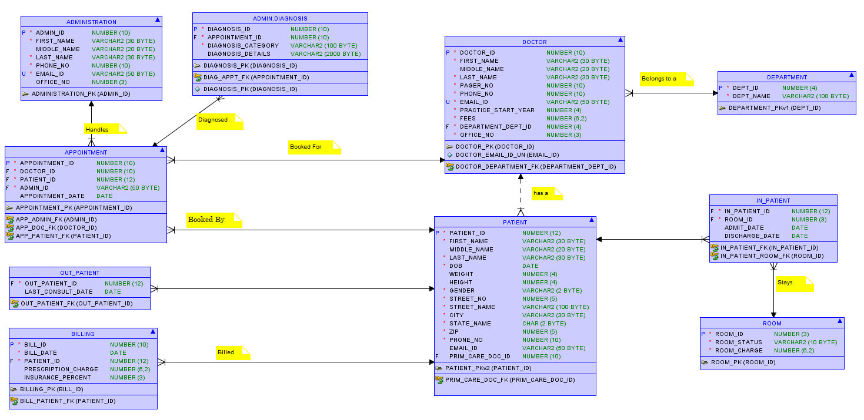
Entity Relationship Diagram

Slide 4
Primary Elements
Table and Sequence Creation with Inserts
Functions
Views
Triggers
Common Procedures
Administrator Packages
Doctor Package
User Creation
Administrator Test Cases
Doctor Test Cases
Patient Test Cases
Reports

Slide 5
Security
There are mainly three types of user access defined in our Hospital DBMS:
Admin Access:
Schedule/cancel appointments.
Create a new patient/doctor profile.
View and update patient/doctor profile.
Cannot access patient’s medical records (diagnosis details)
Doctor Access:
View scheduled appointments.
View patient’s medical history and create new medical records (diagnosis).
Mark them as consulting patients.
Admit Patients.
Discharge Patients.
Generate Bills.
Patient Access:
View diagnosis details and medical history.
View bills.

Slide 6
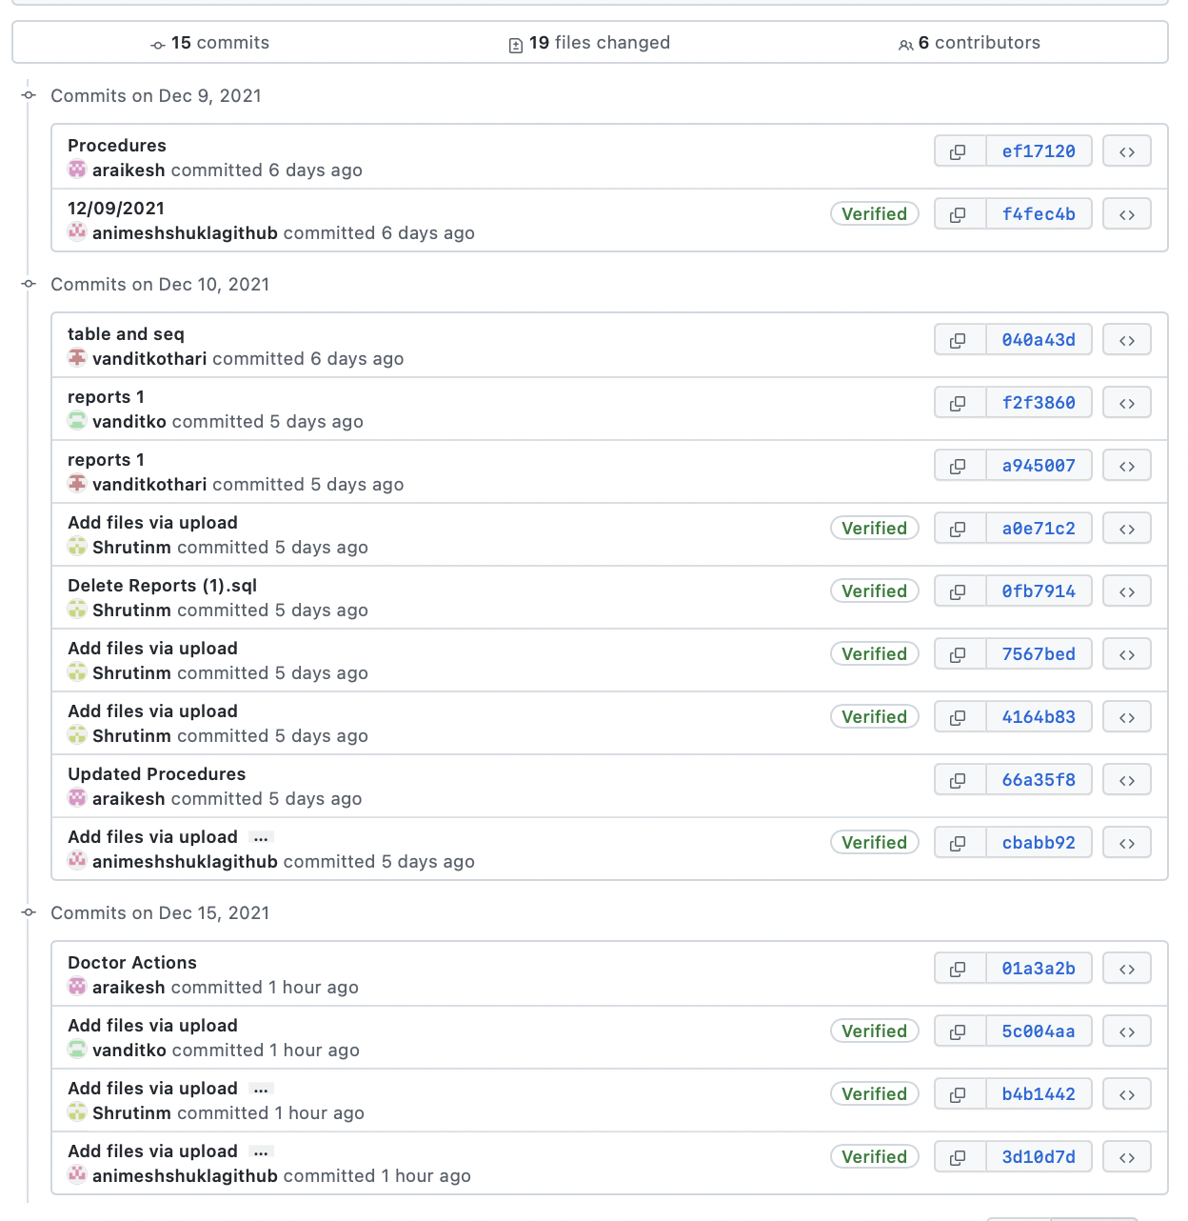
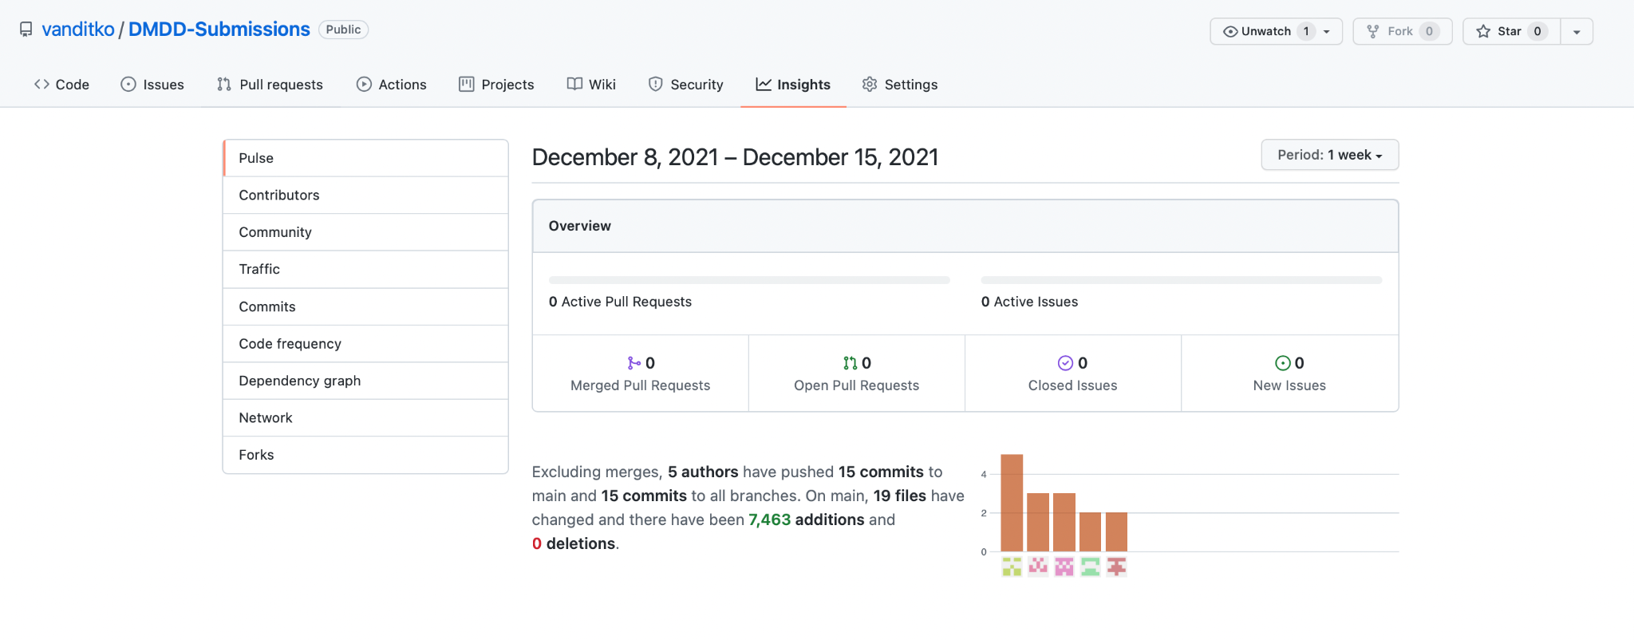
Contribution

Slide 7
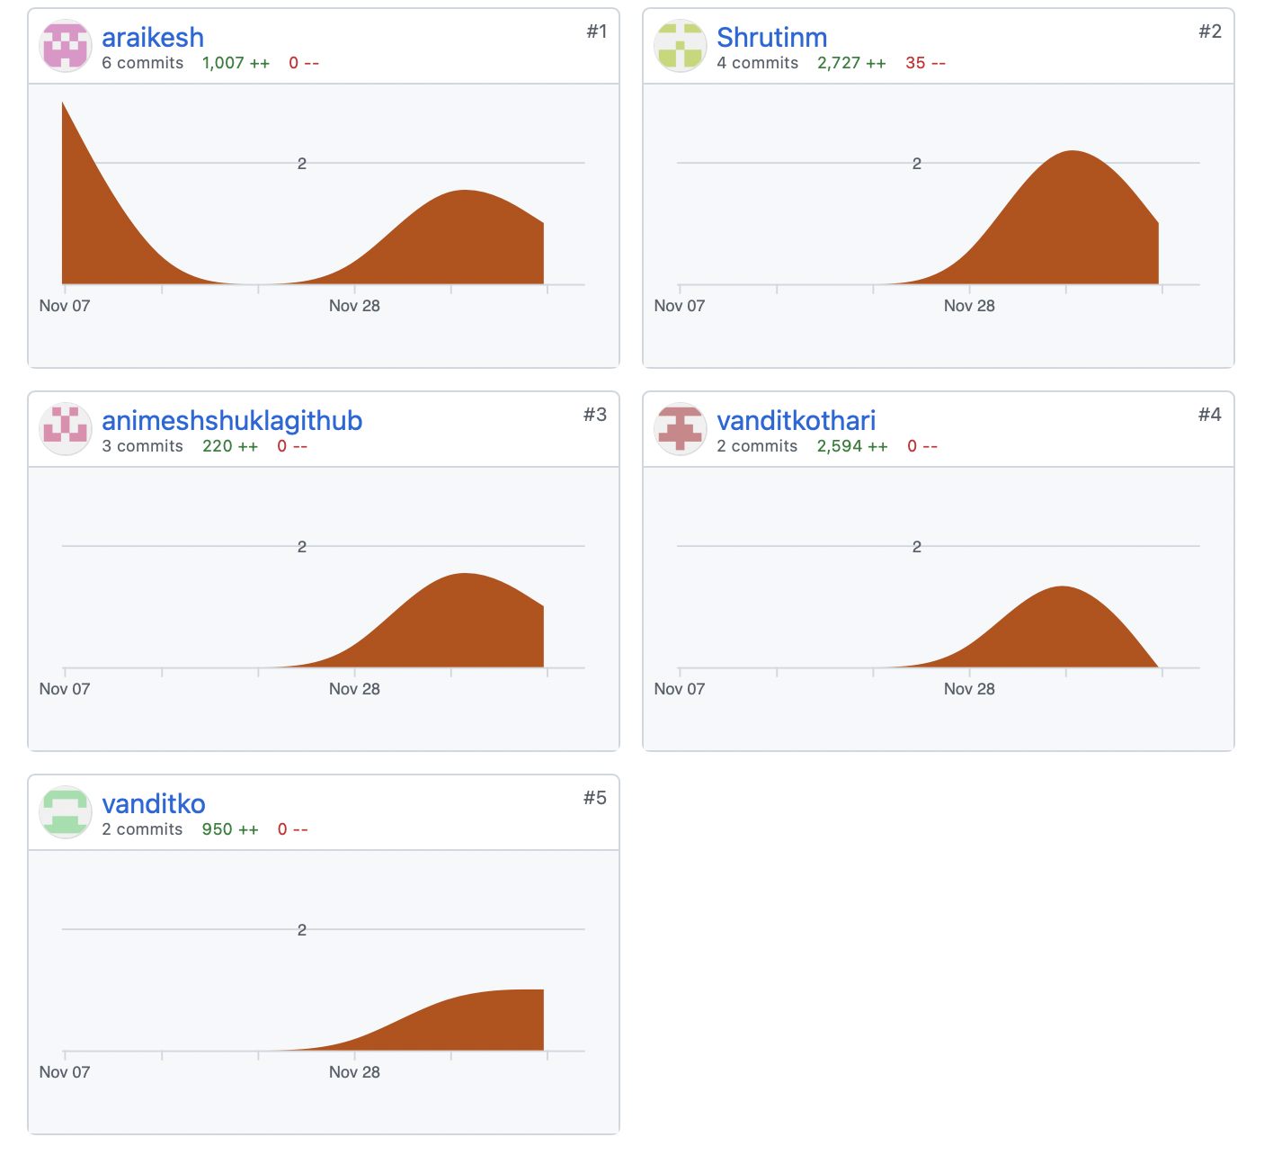
Contribution

Slide 8
Thank You

